Slide 1

PCS Scoreboard
Group 4 Sheikh Md. Salman 1835222660 Rawnak Zarin Khan 1925251060 Fatema Binte Ahmed 1835219660 Yamundow Jah 2016662660 Arafat Ahmed 2016224060
Group 4

Slide 2
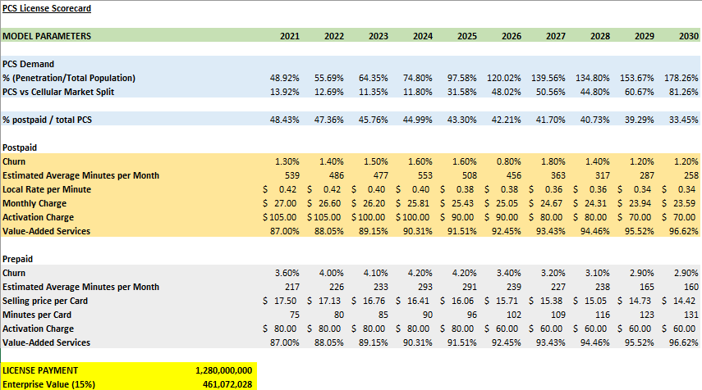
PCS License Score Card

Slide 3
Comparison Between Dreamland and Thailand
Population: 1,424,595 Area: 5,130km² Gross Domestic Product per capita (US$): 7,608
Real Gross Domestic Product growth over the last decade: 4.8%
Dream Land
Population: 69,630,000 Area: 513,120 km² Gross Domestic Product per capita (US$): 7,792.00
Real Gross Domestic Product growth over the last decade: 4.1 %
Thailand

Slide 4
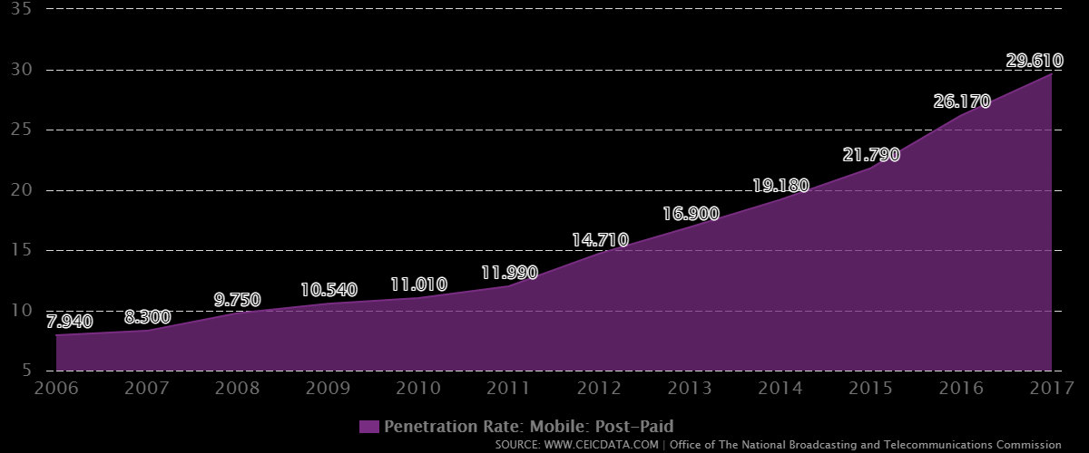
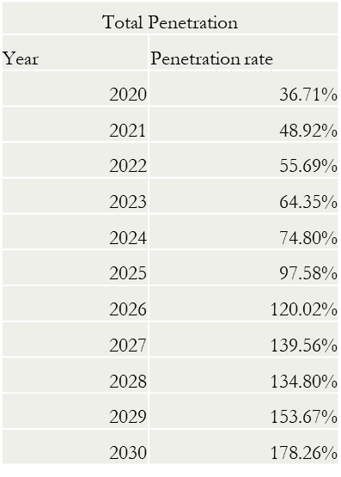
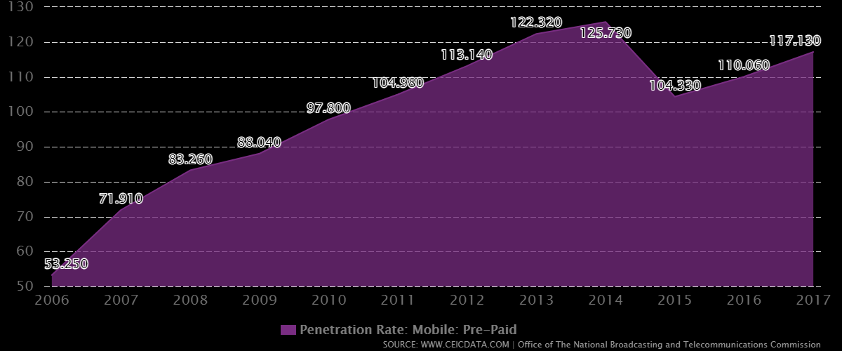
Total Penetration
Total Penetration
Year
Penetration rate
2020
36.71%
2021
48.92%
2022
55.69%
2023
64.35%
2024
74.80%
2025
97.58%
2026
120.02%
2027
139.56%
2028
134.80%
2029
153.67%
2030
178.26%

Slide 5
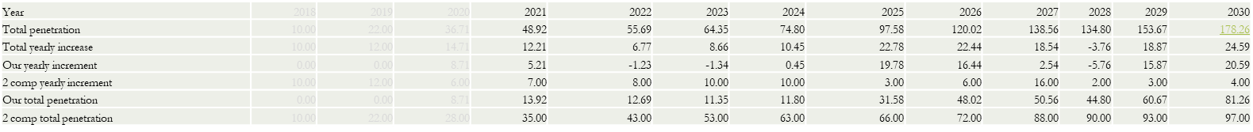
Market Split
2 comp yearly increment
Year | Rate of change
2021 | 7
2022 | 8
2023 | 10
2024 | 10
2025 | 3
2026 | 6
2027 | 16
2028 | 2
2029 | 3
2030 | 4
Market split
Year | % change
2021 | 13.92
2022 | 12.69
2023 | 11.35
2024 | 11.8
2025 | 31.58
2026 | 48.02
2027 | 50.56
2028 | 44.8
2029 | 60.67
2030 | 81.26

Slide 6
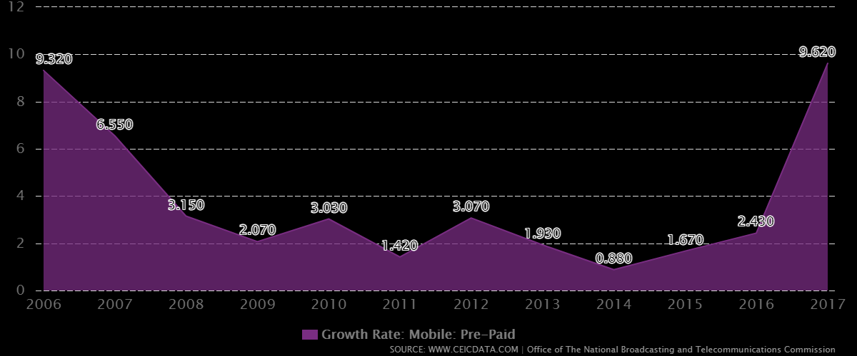
%Postpaid/Total PCS
 | Prepaid | Postpaid
Growth rate | 50% | 50%
3.15 | 51.58% | 48.43%
2.07 | 52.64% | 47.36%
3.03 | 54.24% | 45.76%
1.42 | 55.01% | 44.99%
3.07 | 56.70% | 43.30%
1.93 | 57.79% | 42.21%
0.88 | 58.30% | 41.70%
1.67 | 59.27% | 40.73%
2.43 | 60.71% | 39.29%
9.62 | 66.55% | 33.45%

Slide 7
Churn Rate
Churn Rate (%) | 2013 | 2014 | 2015 | 2016 | 2017 | 2018 | 2019 | 2020
Postpaid | 1.30% | 1.40% | 1.50% | 1.60% | 1.60% | 0.80% | 1.80% | 1.40% | 1.20% | 1.20%
Prepaid | 3.60% | 4.00% | 4.10% | 4.20% | 4.20% | 3.40% | 3.20% | 3.10% | 2.90% | 2.90%
Blended | 3.20% | 3.50% | 3.60% | 3.60% | 3.70% | 2.90% | 2.90% | 2.70% | 2.50% | 2.50%
Churn Rate of True Move in Thailand from 2013 to 2020

Slide 8
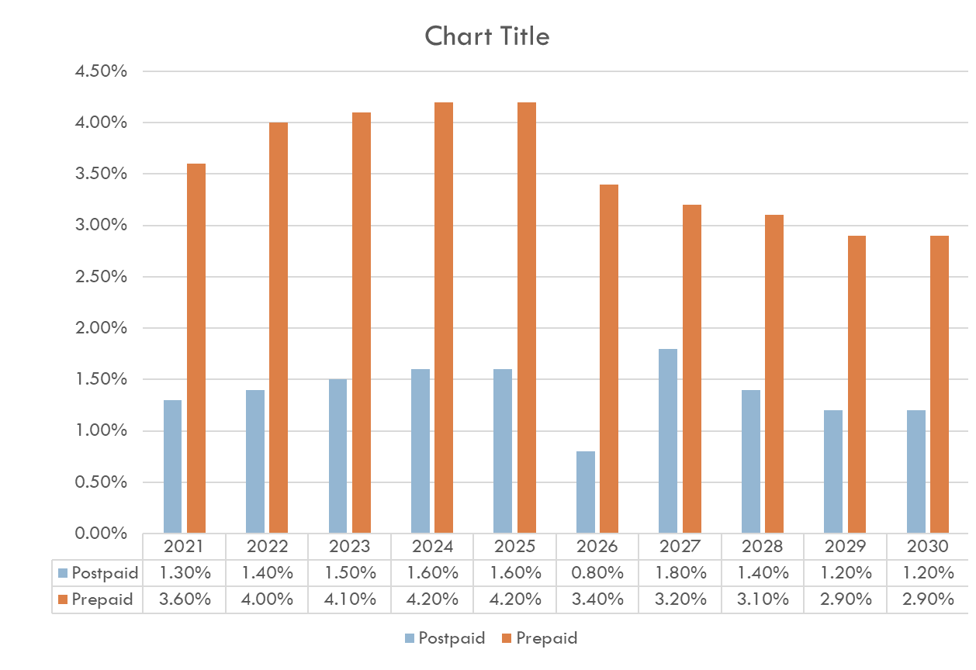
Churn Rate

Slide 9
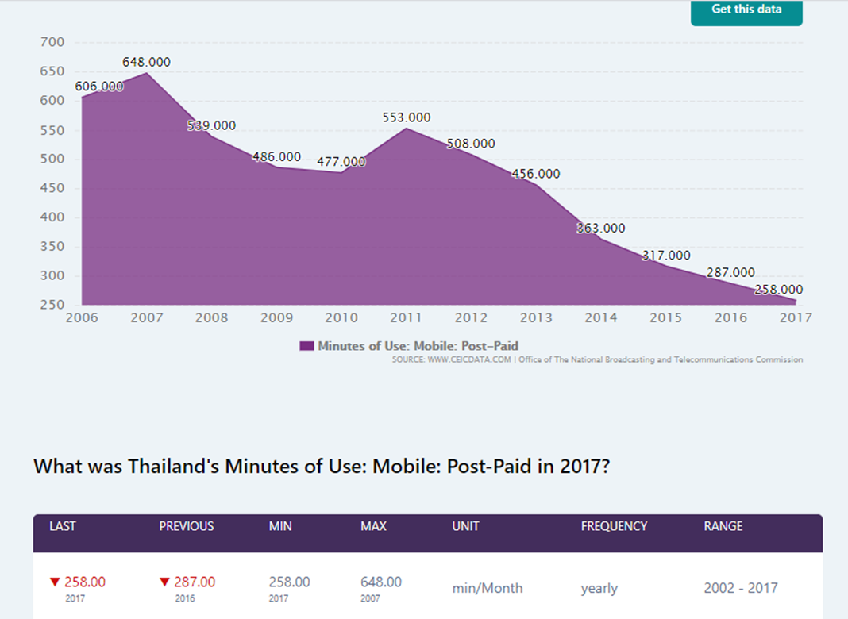
Monthly Usage of Prepaid and Postpaid Talk time of Thailand

Slide 10
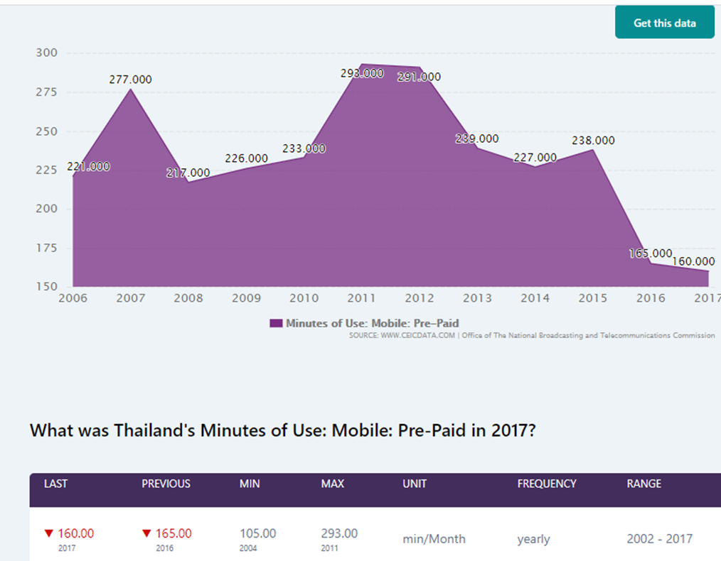
Monthly Usage of Prepaid and Postpaid Talk time of Thailand

Slide 11
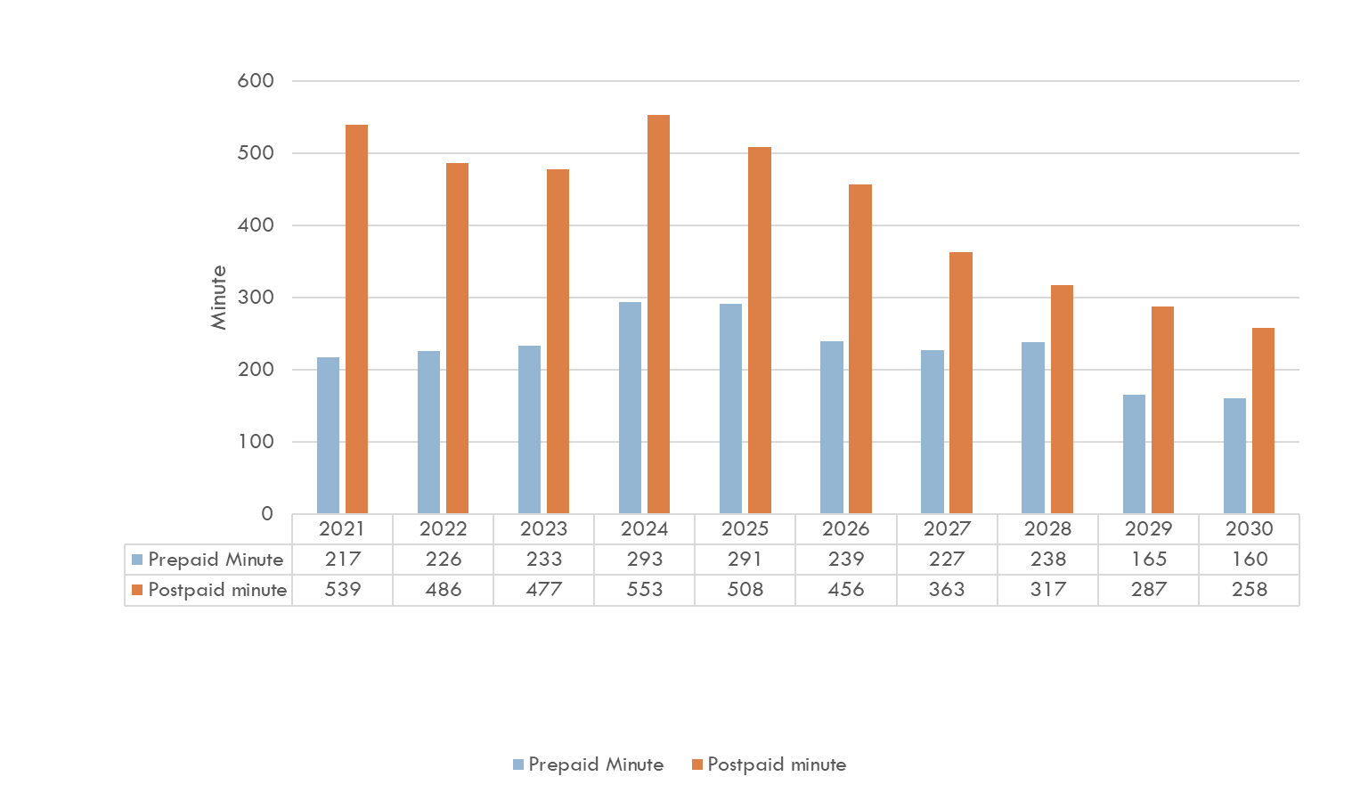
Monthly Usage of Prepaid and Postpaid Talk time of Thailand

Slide 12
Call Rate

Slide 13
Monthly Charge_Postpaid
Year | Monthly Charge
2021 | $27.00
2022 | $26.60
2023 | $26.20
2024 | $25.81
2025 | $25.43
2026 | $25.05
2027 | $24.67
2028 | $24.31
2029 | $23.94
2030 | $23.59

Slide 14
Monthly Charge_Postpaid Setting up Primary value for 2021
Companies | Internet Speed | Calls | Internet | Price ($)
AIS 4G Max Speed | 4G | 250 minutes | 4GB | $28.87
DTAC Go NO LIMIT | 4G | Unlimited DTAC to DTAC | Unlimited | $28.87
TrueMove Unlimited | 4G | 300 minutes | Unlimited | $22.45
My Cat Smart Pack | 3G/4G | 450 minutes | 11GB | $28.87
Average Monthly Charge |  |  |  | $27.27

Slide 15
Monthly Charge_Postpaid Justification for % Change
Year | ARPU (THB/sub/month) | ARPU (USD/sub/month) | Growth | Avg Growth
2007 | 693 | 22.176 |  | -1.49%
2008 | 586 | 18.752 | -15.44%
2009 | 582 | 18.624 | -0.68%
2010 | 582 | 18.624 | 0.00%
2011 | 581 | 18.592 | -0.17%
2012 | 621 | 19.872 | 6.88%
2013 | 606 | 19.392 | -2.42%
2014 | 596 | 19.072 | -1.65%
2015 | 542 | 17.344 | -9.06%
2016 | 556 | 17.792 | 2.58%
2017 | 567 | 18.144 | 1.98%
2018 | 552 | 17.664 | -2.65%
2019 | 567 | 18.144 | 2.72%

Slide 16
Selling price per Card_Prepaid
Year | Selling Price Per Card
2021 | $17.50
2022 | $17.13
2023 | $16.76
2024 | $16.41
2025 | $16.06
2026 | $15.71
2027 | $15.38
2028 | $15.05
2029 | $14.73
2030 | $14.42

Slide 17
Selling price per Card_Prepaid Setting up Primary value for 2021
Types of Prepaid Packages (considering 30 Days duration)
Type of Rates | Type 1 | Type 2 | Type 3 | Type 4 | Type 5
Companies:
AIS | $9.63 | $11.24 | $20.87 | $27.30 | $35.65
DTAC | $9.60 | $12.81 | $22.45 | $25.66 | $64.19
True Move | $9.63 | $11.24 | $20.87 | $25.66 | $51.35
My Cat | $9.60 | $12.81 | $19.24 | $28.87 | $32.08
Type of Rates | Total Subscriber (In Million) | Total Prepaid Subscriber (in million) | Total Number of cards Sold (in million) | Type 1 | Type 2 | Type 3 | Type 4 | Type 5 | Total | Average
AIS | 41 | 31.48 | 47.22 | $181.89 | $106.15 | $147.82 | $193.37 | $168.34 | $797.57 | $16.89
DTAC | 18.8 | 12.7 | 19.05 | $73.15 | $48.81 | $64.15 | $73.32 | $122.28 | $381.71 | $20.04
True Move | 30.64 | 21.15 | 31.725 | $122.20 | $71.32 | $99.32 | $122.11 | $162.91 | $577.86 | $18.21
My Cat | 2.88 | 2.7 | 4.05 | $15.55 | $10.38 | $11.69 | $17.54 | $12.99 | $68.15 | $16.83
Averaged Selling Price Per Card |  |  |  |  |  |  |  |  |  | $17.99

Slide 18
Selling price per Card_Prepaid Justification for % Change
Year | ARPU (THB/sub/month) | ARPU (USD/sub/month) | Growth | Avg Growth
2007 | 197 | 6.304 |  | -2.13%
2008 | 164 | 5.248 | -16.75%
2009 | 162 | 5.184 | -1.22%
2010 | 160 | 5.12 | -1.23%
2011 | 158 | 5.056 | -1.25%
2012 | 158 | 5.056 | 0.00%
2013 | 140 | 4.48 | -11.39%
2014 | 136 | 4.352 | -2.86%
2015 | 178 | 5.696 | 30.88%
2016 | 159 | 5.088 | -10.67%
2017 | 154 | 4.928 | -3.14%
2018 | 148 | 4.736 | -3.90%
2019 | 142 | 4.544 | -4.05%

Slide 19
Minutes per Card_Prepaid
Year | Minutes per card
2021 | 75
2022 | 80
2023 | 85
2024 | 90
2025 | 96
2026 | 102
2027 | 109
2028 | 116
2029 | 123
2030 | 131

Slide 20
Minutes per Card_Prepaid Setting up Primary value for 2021
Prepaid offers for different operators
Operator | Speed | Internet | Minutes | Price
AIS | 384 kbps | NA | 15 | 49 baht
 | 2.5gb | 8 Days | 100 | 299 baht
 | 6gb | 15 Days | 100 | 599 baht
DTAC | 384 kbps | NA | 20 | 49 baht
 | 2.5gb | 8 Days | 100 | 299 baht
 | 6gb | 15 Days | 100 | 599 baht
True Move | 90mb | NA | 20 | 49 baht
 | 2.5gb | 8 Days | 100 | 299 baht
 | 8gb | 15 Days | 50 | 599 baht
My Cat | 1.5gb | 7 days | 100 | 299 baht
Minutes per card | Type 1 (49 Baht) | Type 2 (299 Baht) | Type 3 (599 Baht) | Average
AIS | 15 | 100 | 100 | 71.67
DTAC | 20 | 100 | 100 | 73.33
True Move | 20 | 100 | 50 | 56.67
My Cat | NA | 100 | NA | 100.00
Averaged Minutes Per Card |  |  |  | 75.42

Slide 21
Minutes per Card_Prepaid Justification for % Change
Year | Prepaid Subscriber | MOU | Minutes Per Month | Growth for Minutes Per Month | Avg Growth for Minutes Per Month
 |  | (Minutes/Sub/Month)
2009 | 58.90137 | 226 | 13311.70962 |  | 6.43%
2010 | 64.469827 | 233 | 15021.46969 | 12.84%
2011 | 69.510532 | 217 | 15083.78544 | 0.41%
2012 | 75.229228 | 220 | 16550.43016 | 9.72%
2013 | 82.256949 | 240 | 19741.66776 | 19.28%
2014 | 84.520726 | 210 | 17749.35246 | -10.09%

Slide 22
Activation Charge – Postpaid

Slide 23
Activation Charge – Prepaid

Slide 24
Value Added Services
Thailand (% of ARPU (Average Revenue Per User))
Value Added Services
Year | 2021 | 2022 | 2023 | 2024 | 2025 | 2026 | 2027 | 2028 | 2029 | 2030
Mobile Data % | 80.00% | 81.13% | 82.27% | 83.43% | 84.61% | 85.80% | 87.01% | 88.24% | 89.48% | 90.74%
SMS/MMS % | 4.00% | 4.08% | 4.16% | 4.24% | 4.33% | 4.11% | 3.91% | 3.71% | 3.53% | 3.35%
Downloading ringtones | 1.00% | 0.80% | 0.64% | 0.51% | 0.41% | 0.33% | 0.26% | 0.21% | 0.17% | 0.13%
Entertainment | 2.00% | 2.04% | 2.08% | 2.12% | 2.16% | 2.21% | 2.25% | 2.30% | 2.34% | 2.39%
Total VAS % | 87.00% | 88.05% | 89.15% | 90.31% | 91.51% | 92.45% | 93.43% | 94.46% | 95.52% | 96.62%

Slide 25
License Fee
Calculation basis for license fee
License fee for Dreamland: USD 1.28 billion

Slide 26
Links
https://www.dtac.co.th/en/prepaid/simdtac.html
http://www.onesimcard.com/cell-phone-rates/thailand/#rates_table
https://www.bangkokpost.com/business/1468406/true-move-h-says-itll-sit-out-1800mhz-bid
https://www.nationthailand.com/Corporate/30358865

